Slide 1
IOT based Health Monitoring System for Elderly

Slide 2
Project title - IOT based Health Monitoring System for Elderly
Name - Vishal Sharma
Reg. No. - 14BCE0298
Guide Name – Sasikala R

Slide 3
The 4 components of project

Slide 4
Architecture of the proposed work

Slide 5
Data uploaded to Thingspeak Cloud
S.no | Data | Mode | Frequency | Link to Channel
1 | BPM | ESP-8266 based IOT system | Every 30 seconds when system is turned on | https://thingspeak.com/channels/428871
2 | Temperature | ESP-8266 based IOT system | Every 1 minute when system is turned on | https://thingspeak.com/channels/414656
3 | Latitude | Android application | User triggered | https://thingspeak.com/channels/440119
4 | Longitude | Android application | User triggered | https://thingspeak.com/channels/449505
5 | Medicine Schedule | Android application | Triggered by medicine reminder alert | https://thingspeak.com/channels/459257/feed.csv

Slide 6
E-mail alerts send by IFTTT events
S.no | Event name | Condition | Cloud storage links to | Significance
1 | Monitoring _system | Switching the ESP-8266 system ON | Temperature, Latitude, BPM, Longitude, Medicine File | Tells family member that user has started uploading data.
2 | fever | Temperature above 38° celcius for 2 consecutive readings | Temperature, Latitude, BPM, Longitude, Medicine File | Tells family member that user has high body temperature.
3 | Heart_attack | BPM above 150 or below 50 for 2 consecutive readings | Temperature, Latitude, BPM, Longitude, Medicine File | Tells family member that user’s heart is behaving abnormally.
4 | Daily_Alert | Turning OFF alarm in android application | Temperature, Latitude, BPM, Longitude, Medicine File | Tells family member that user has turned off alarm and is awake.
5 | Check_reminder | Every Monday, Wednesday, Friday, Sunday at 9 PM | Temperature, Latitude, BPM, Longitude, Medicine File | Reminds family member to check user uploads.

Slide 7
Component 1 - IOT System

Slide 8
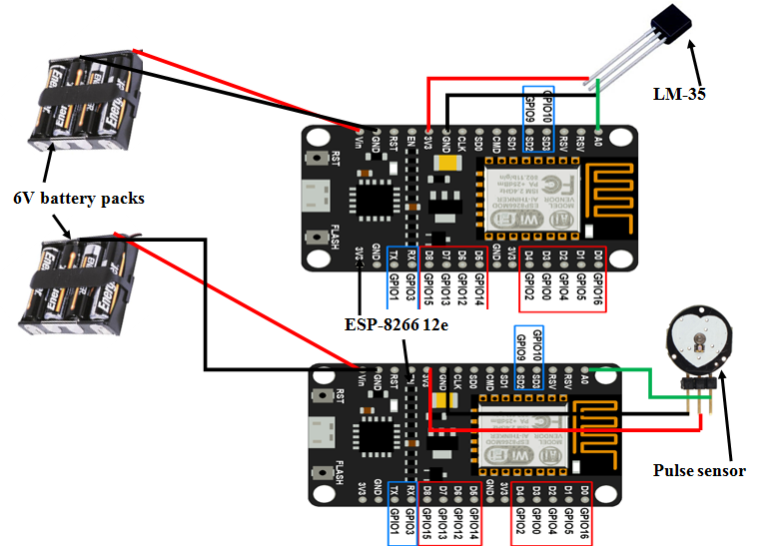
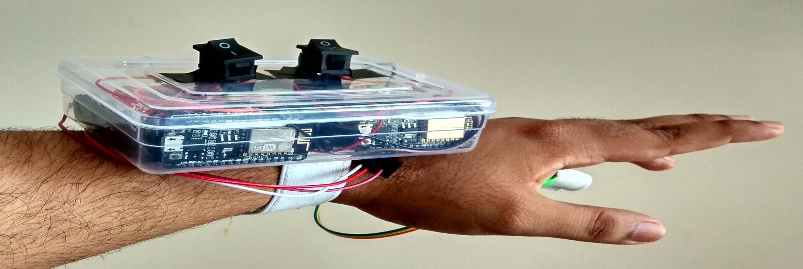
Component 1 - IOT System

Slide 9
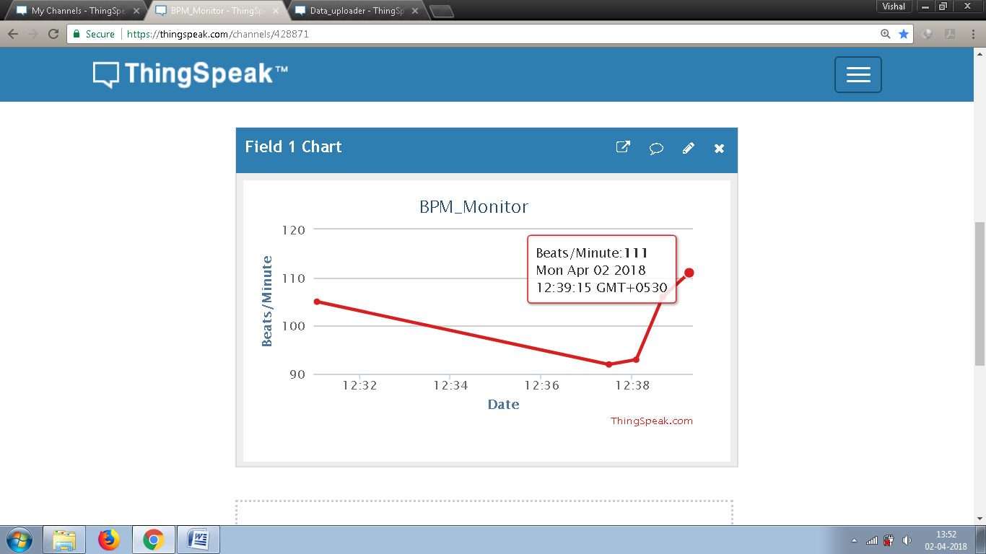
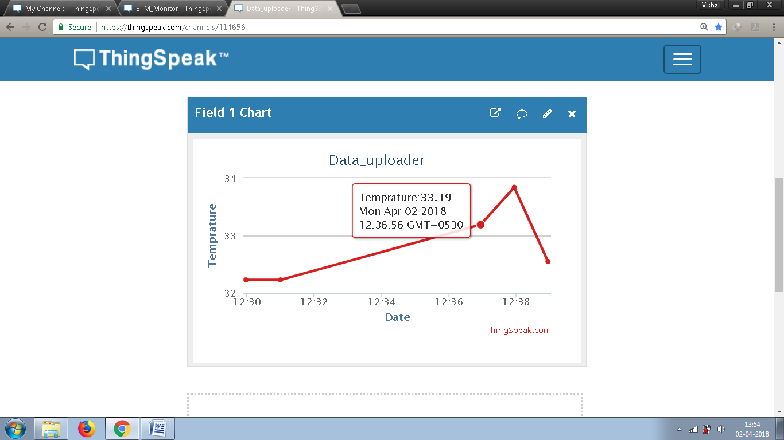
Component 1 - IOT System
Visualization of uploaded BPM values
Visualization of uploaded Temperature values

Slide 10
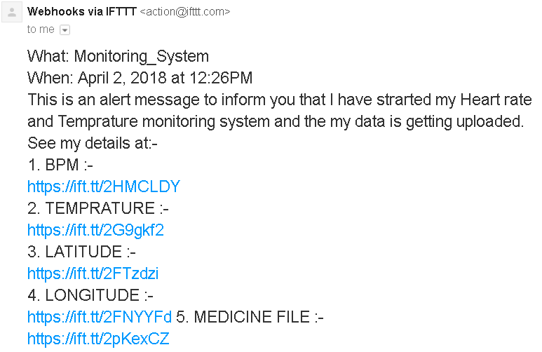
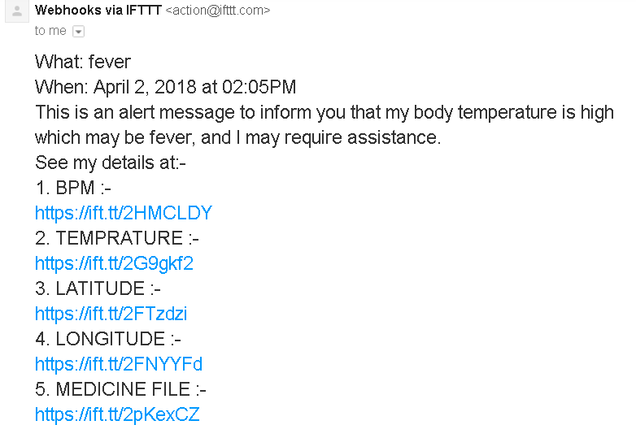
Email alerts send by System

Slide 11
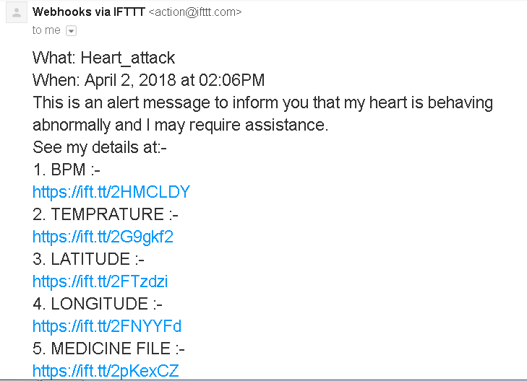
Alert send based on BPM values

Slide 12
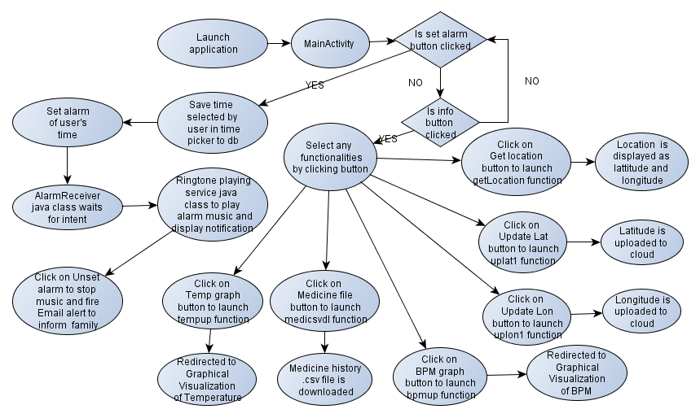
Component 2 - Android Application Mydemo15

Slide 13
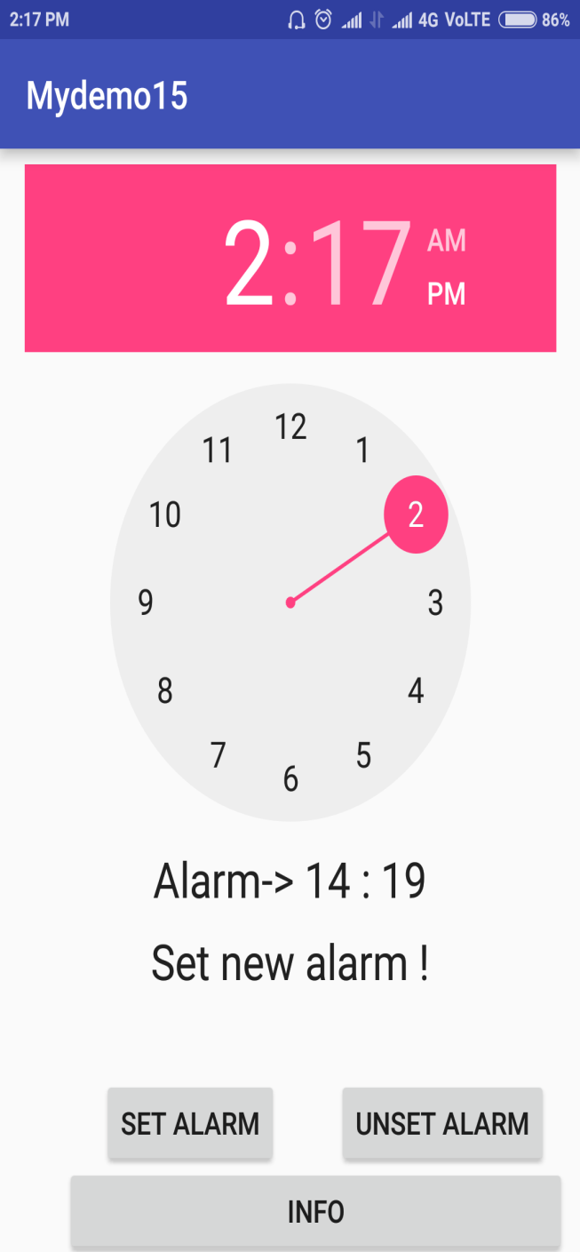
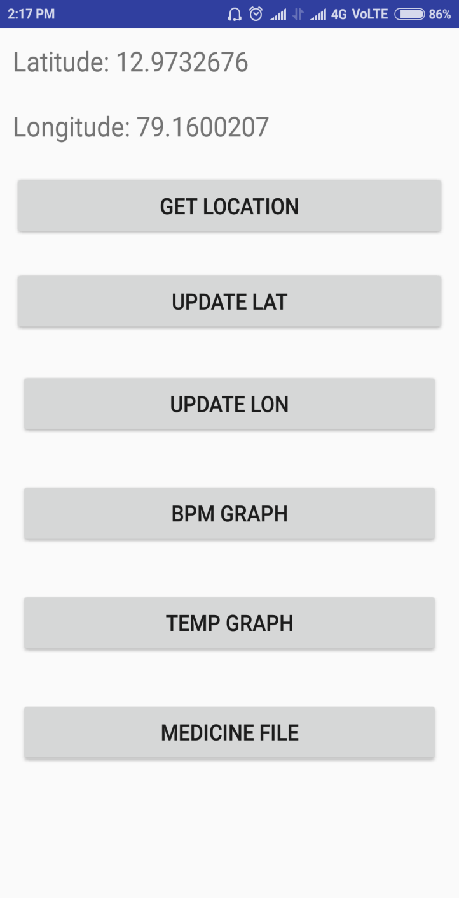
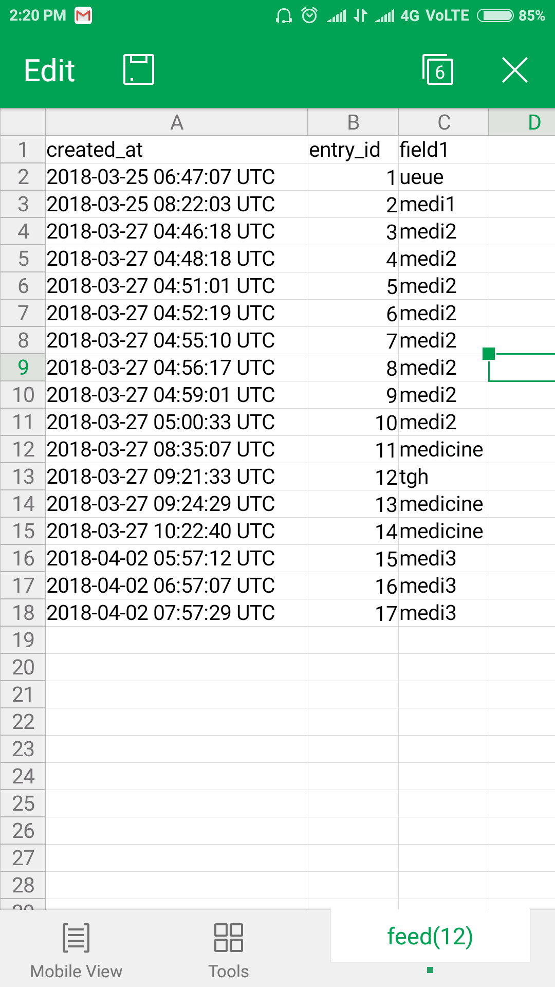
Application Screenshots

Slide 14
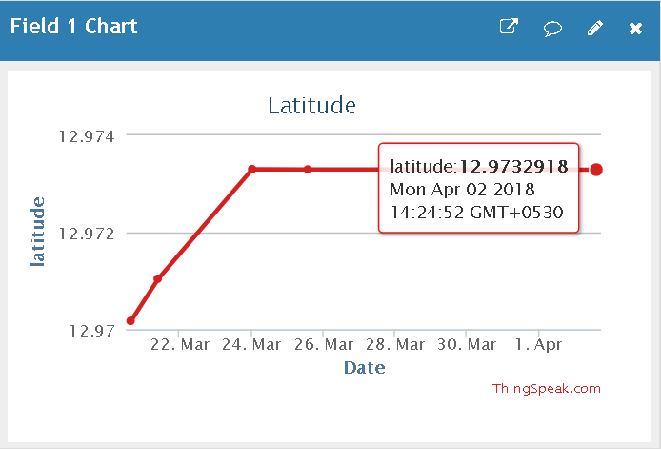
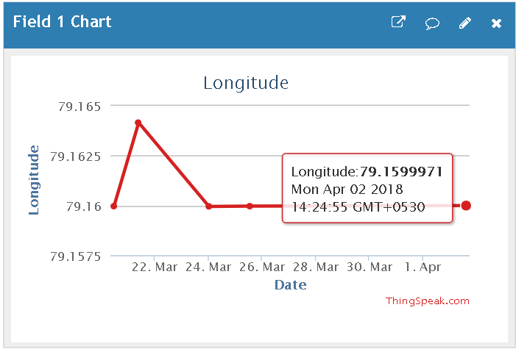
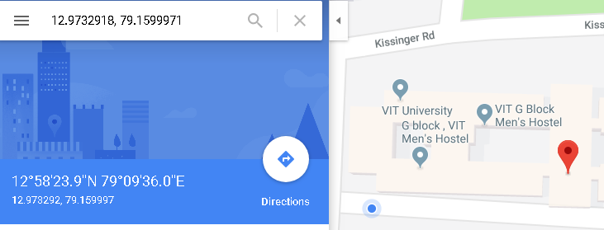
Getting Location based on Latitude and Longitude from uploaded data

Slide 15
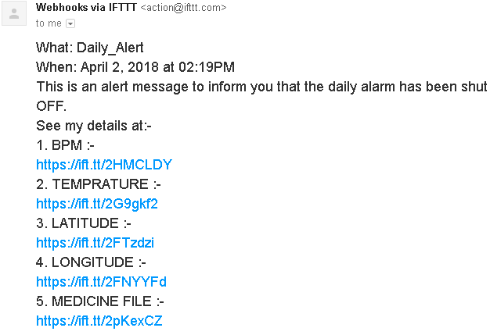
Alert sent when alarm is turned off

Slide 16
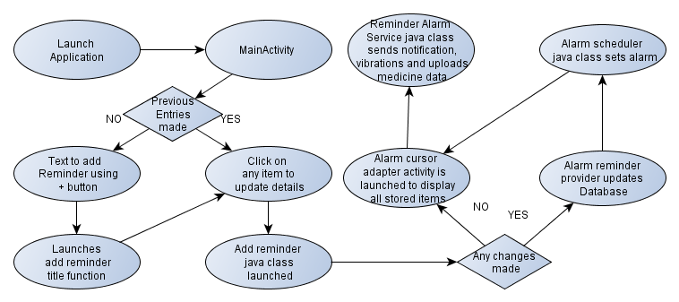
Component 3 - Android Application Mydemo12

Slide 17
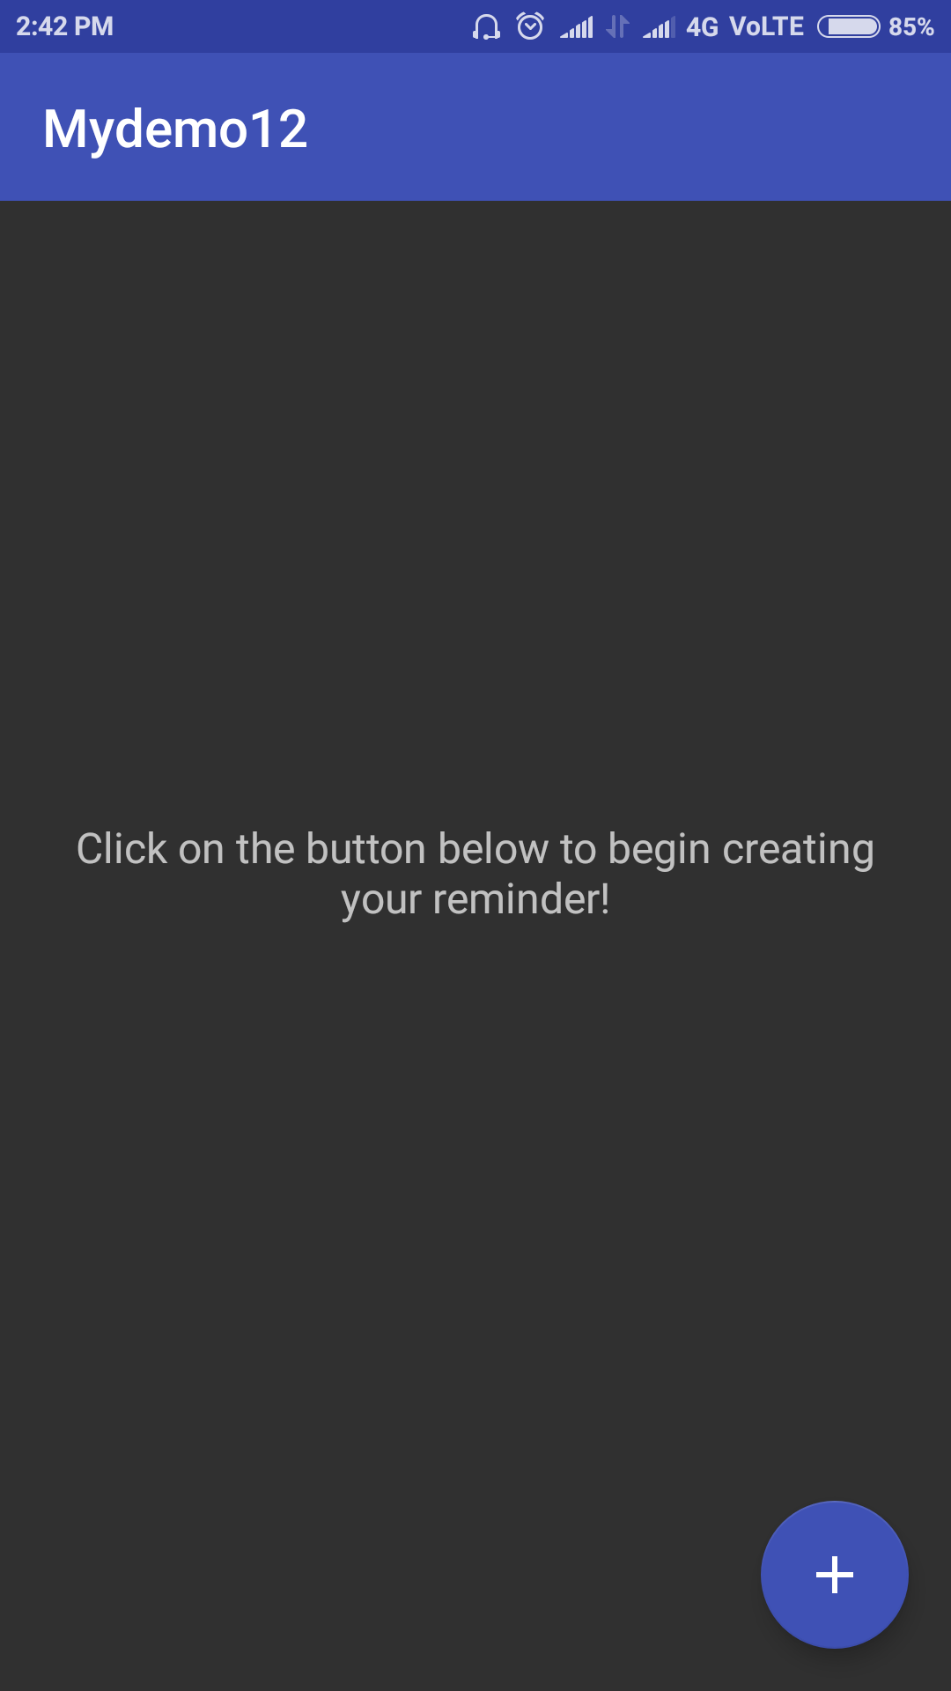
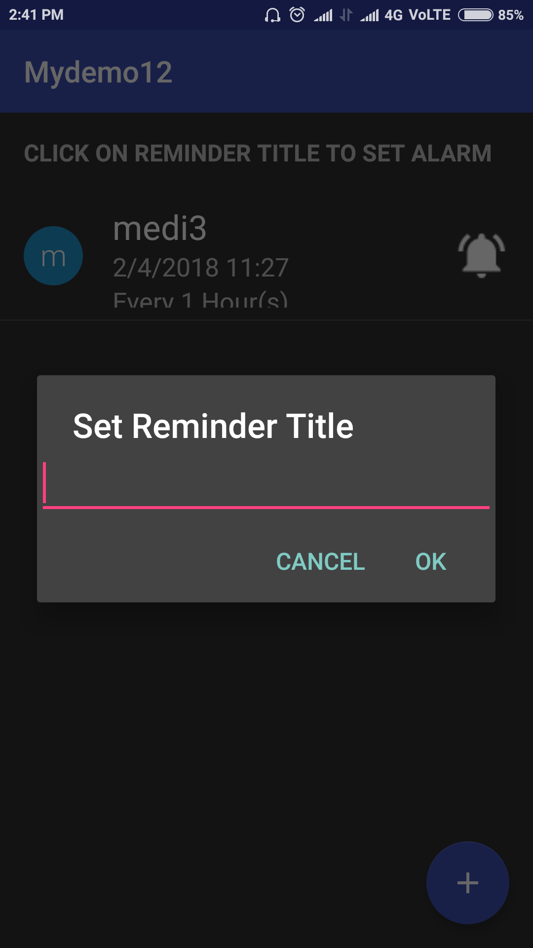
Screenshots of application

Slide 18
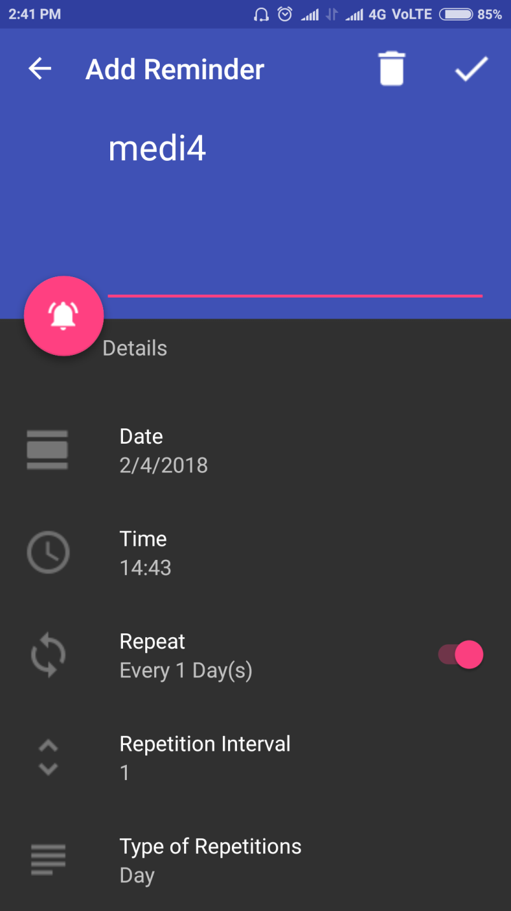
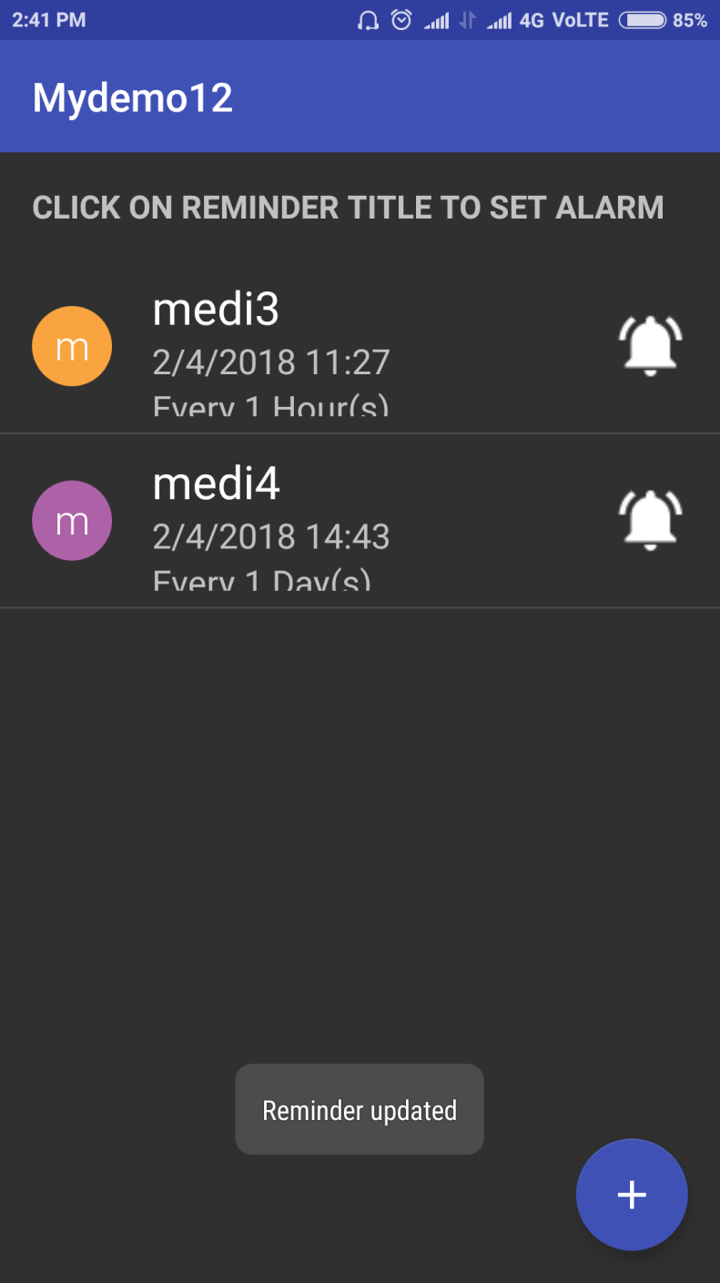
Setting up repeating reminder

Slide 19
Component 4 – Web application based on Mamdani linguist rules

Slide 20
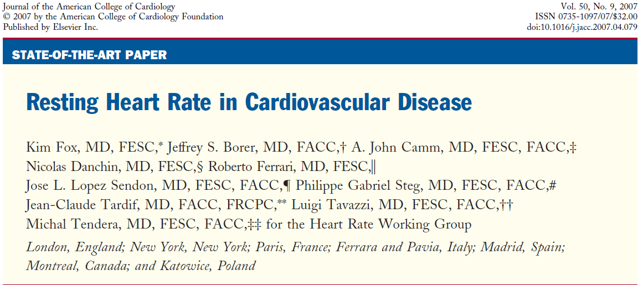
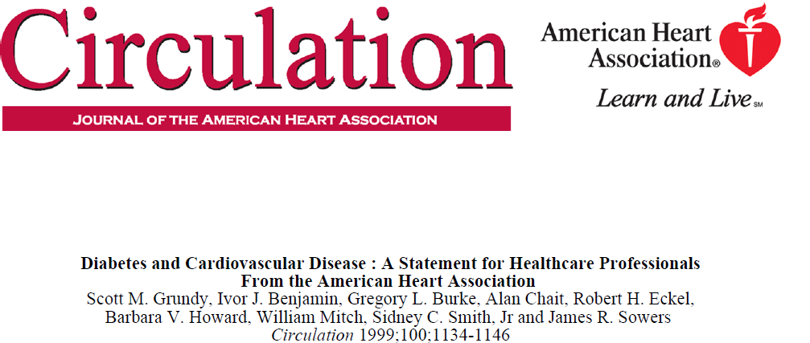

Sources for rules used in risk identification

Slide 21
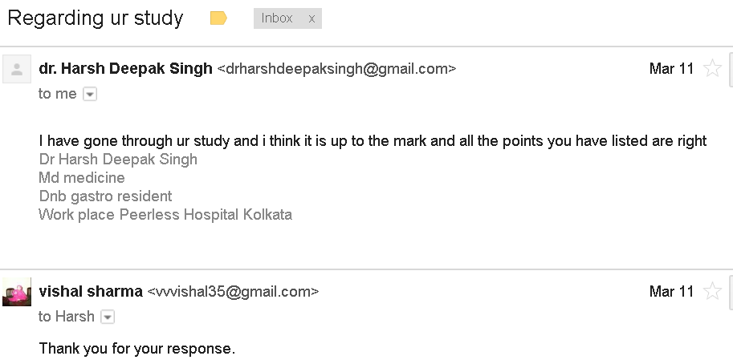
Mail of acceptance for factors included
Primary membership function
factors:-
Age
Average Heart Rate
Previous Heart History
Secondary membership function factors:-
Diabetes
Smoking
Cholesterol
Family history

Slide 22
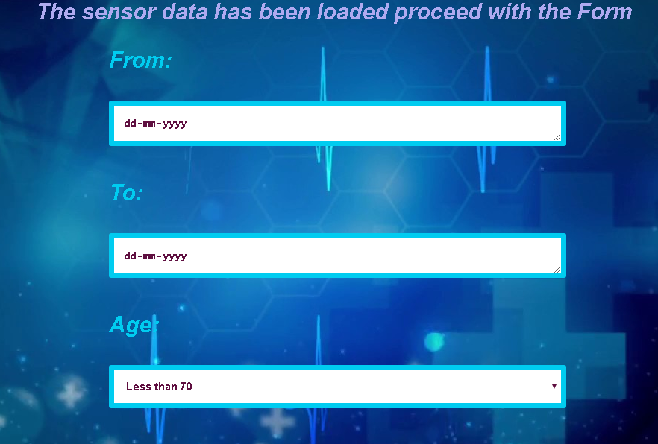
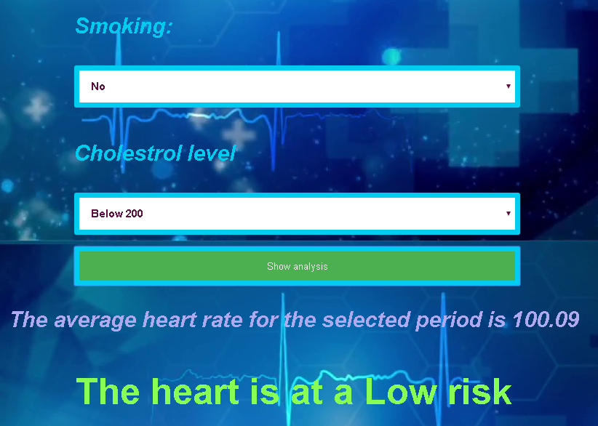
Screenshots of application

Slide 23
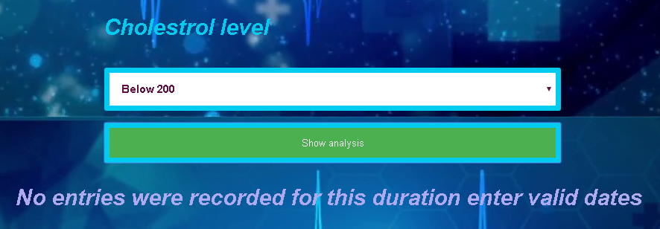
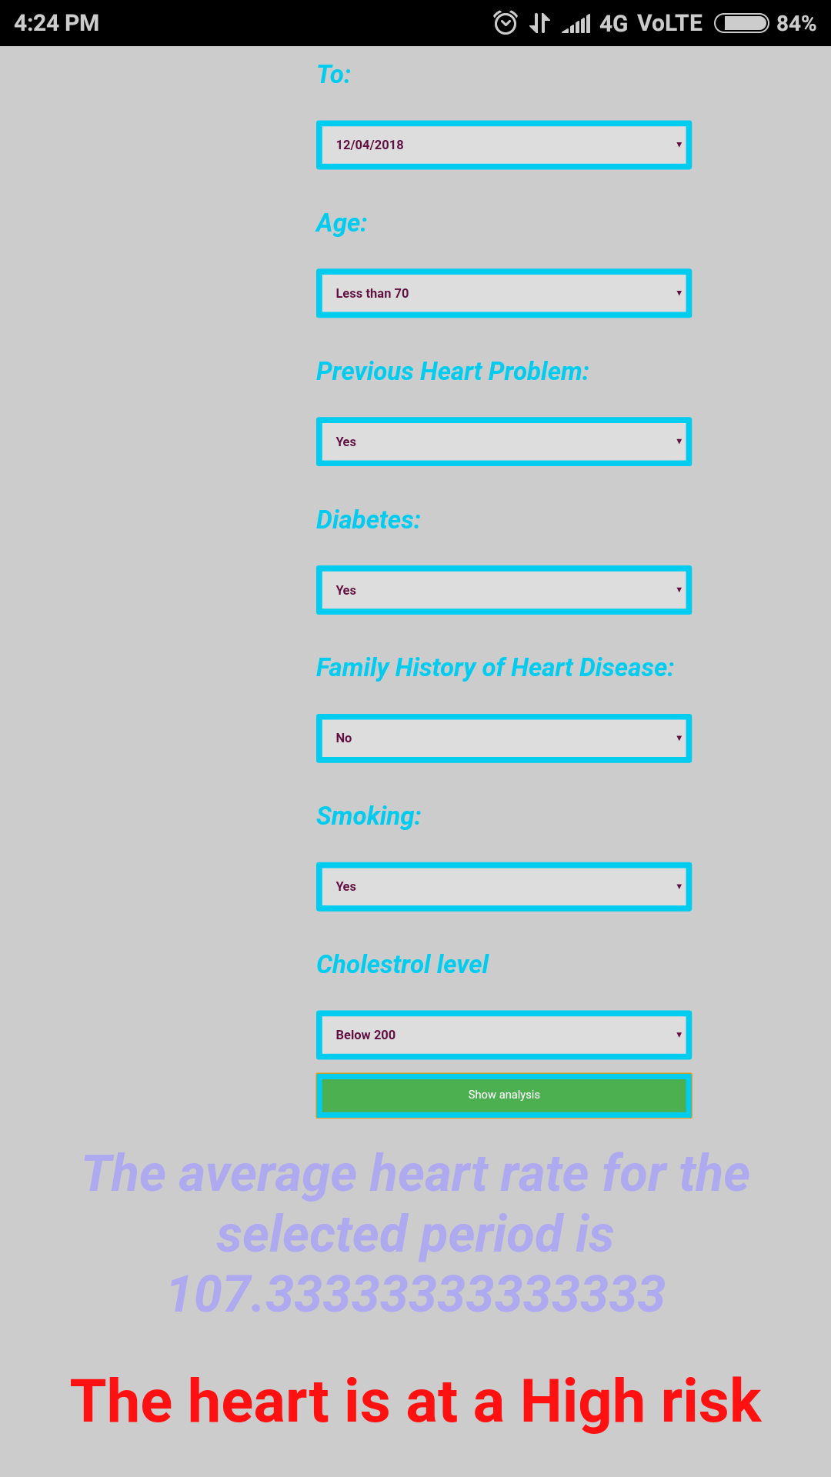
Working on computer/mobile

Slide 24
Conclusion, Limitations and Scope for future Work
In conclusion I would like to state that the combined efforts of the four components are capable of collecting, uploading and sharing information about the user at regular intervals and frequencies dictated by user’s need. The user and a family member can be aware of user’s heart rate, body temperature, location and medicine history along with risk analysis of user’s heart condition.
The limitation of the project is that all alerts are in the form of E-mails at the moment, another limitation is the delay in alarm and reminder triggering due the fact that after the api 19 used for android development the trigger time passed is treated in exact i.e the alarm and reminder will not be delivered before the mentioned time but are deferred and delivered some
time later.
The future for the project can include use of power banks to power IOT system which will also allow user to charge his smartphone if needed. Another update cloud be developing a family member specific application for providing updates along with email alerts.

Slide 25
References
[1]. Bandana Mallick, Ajit Kumar Patro, on Heart Rate Monitoring System Using Finger Tip Through Arduino And Processing Software, International Journal of Science, Engineering and Technology Research (IJSETR), Volume 5, Issue 1, January 2016
[2]. Nusrat Jahan Farin, S. M. A. Sharif, Iftekharul Mobin on An Intelligent Sensor Based System for Real Time Heart Rate Monitoring (HRM), Intelligent Control and Automation, 2016, 7, 55-62 Published Online May 2016 in SciRes
[3]. Vikramsingh R. Parihar, Akesh Y. Tonge, Pooja D. Ganorkar, on Heartbeat and Temperature Monitoring System for Remote Patients using Arduino, International Journal of Advanced Engineering Research and Science (IJAERS), Vol-4, Issue-5, May- 2017
[4]. James B. Strait, Edward G. Lakatta, Aging-associated cardiovascular changes and their relationship to heart failure, Laboratory of Cardiovascular Science, Intramural Research Program, National Institute on Aging, National Institutes of Health, Baltimore, MD, PMC 2013 Jan 1.
[5]. Kim Fox, MD, FESC, Jeffrey S. Borer, MD, FACC, Resting Heart Rate in Cardiovascular Disease, Journal of the American College of Cardiology, Vol. 50, No. 9, 2007
[6]. Anxin Wang , Shuohua Chen, Resting Heart Rate and Risk of Cardiovascular Diseases and All- Cause Death: The Kailuan Study, October 24, 2014 https://doi.org/10.1371/journal.pone.0110985
[7]. https://www.udemy.com/complete-android-n-developer-course/learn/v4/content
[8]. https://www.udemy.com/complete-guide-to-build-iot-things-from-scratch-to-market/
[9].https://www.udemy.com/arduino-programming-and-hardware-fundamentals-with- hackster/learn/v4/content
[10]. https://www.youtube.com/channel/UCZ00VgbuL3218mXA0_drptg
[11]. Pfister, Cuno. Getting Started with the Internet of Things: Connecting Sensors and Microcontroller to the Cloud. " O'Reilly Media, Inc.", 2011.

